Slide 1
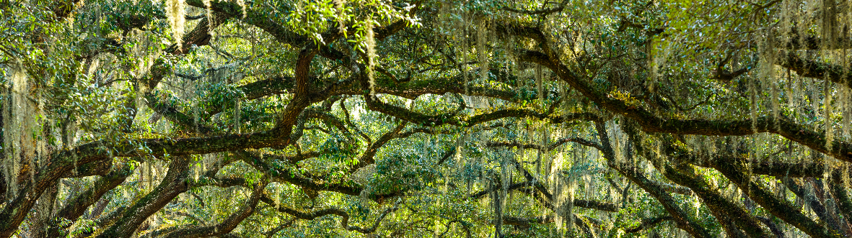


AI Academy Apprenticeship Capstone Tree Coverage
Sage Reagan

Slide 2
Agenda
1
2
3
4
5
Project Goals Business case
Data Data understanding and preparation
Methods
Proposed team
Result
Our capabilities
We’ve Been Down this Road Before
Our experience

Slide 3
Project Goals
Complete a Machine Learning Model for a Business Case

Slide 4
Business Understanding
Apprenticeship capstone – tree coverage
The business case that will be addressed in this capstone.
INUSTRY | Stakeholder | Location
Forest and Land Management | Bureau of Land Management | Roosevelt National Park
PROBLEM | Reasoning | Other considerations
Determine which trees are Lodgepole Pine trees based on the surrounding forest characteristics | Bureau of Land Management wants to thin the forest so trees won’t have to fight for light or water. There is an abundancy of Lodgepole Pine tress and cutting them down would help with the forest’s health as well as selling their lumber would be financially beneficial | The Bureau of Land Management does not want to cut down other types of trees as it will not help with the health of the forest and the lumber is worth less.
Notes:
Client: Bureau of Land Management
Industry: Forest and Land Management Industry
Where: Roosevelt National Park
What: Determine which trees are Lodgepole Pine trees based on the surrounding forest characteristics
Why: Want to thin the forest so trees won’t have to fight for light and water, and have decided there is an abundancy of Lodgepole Pine tress and cutting them down would help with the forest as well their lumber being financially beneficial.
Other considerations: the Bureau of Land Management does not want to cut down other types of trees as it will not help with the health of the forest and the lumber is worth less

Slide 5
Data
Data Understanding and Preparation

Slide 6

Data Understanding
Apprenticeship capstone – tree coverage
Variables that will be used in this capstone.
Target Variable:
Tree Coverage Type
SHADE ON HILLSIDE AT 9AM, 12PM, 3PM
ELEVATION
Hillside shade index at given times (0 – 225 index)
10
1
Elevation in meters
SPECIFIC WILDERNESS AREA
ASPECT
9
2
Aspect in degrees azimuth
Wilderness area (4 different areas – binary representation)
SOIL TYPE
SLOPE
8
3
Slope in degrees
Type of soil (40 different types – binary representation)
DISTANCE TO FIREPOINTS
DISTANCE TO ROADWAYS
Horizontal distance to nearest wildfire ignition point
7
4
Horizontal distance to nearest roadway
VERTICAL DISTANCE TO HYDROLOGY
HORIZONTAL DISTANCE TO HYDROLOGY
Vertical distance to nearest water feature
6
5
Horizontal distance to nearest water feature
Dataset Source:
Notes:
Bigger tree with more endpoints, points coming off it
Spell check

Slide 7

Data Preparation
Apprenticeship capstone – tree coverage
What was done to pre-process the data before inserting it into a machine learning model.
7
Data in original form had a class imbalance.
Lodgepole Pine had most of the records.
Class Imbalance
Originally 7 Types of Trees
Binary Classification
Spruce/Fir (211,840)
Lodgepole Pine (283,301)
Ponderosa Pine (35,754)
Cottonwood/Willow (2,747)
Aspen (9,493)
Douglas-Fir (17,367)
Krummholz (20,510)
Solution: Combine all types of trees outside Lodgepole Pine
283,301 records of Lodgepole Pine trees and 291,771 other trees.
This is only a 2.9% difference
Notes:
Switch graphic. Left side just first one
Entire right side have top and bottom section (problem and solution) arrow pointing
Mention that every data was already cleaned

Slide 8
Methods
Decision Tree Model
Notes:
Machine Learning Model: Decision Tree Classifier
Classification Type: Binary Classification
Tools: Python packages and Github
Evaluation metrics: Precision, Recall, Accuracy, F1
Metric Prioritization: It is more important to cut down the correct type of tree while not harming other types of trees, also we do not want to cut down all the Lodgepole Pine trees so if we miss some in the categorization, it wont be as harmful as mis categorizing other types of trees. Therefor, it is more important to have more false negatives than false positives and I will be prioritizing precision over recall.

Slide 9
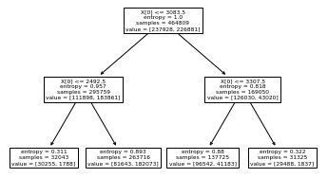
Methodology
Apprenticeship capstone – tree coverage
Classification, tools, and metrics.
Methodology Overview
Decision Tree Classifier Example
Machine Learning Model
Decision Tree Classification
Classification Type
Binary Classification
Tools Used
Python Packages
GitHub
Notes:
Machine Learning Model: Decision Tree Classifier
Classification Type: Binary Classification
Tools: Python packages and Github
Evaluation metrics: Precision, Recall, Accuracy, F1
Metric Prioritization: It is more important to cut down the correct type of tree while not harming other types of trees, also we do not want to cut down all the Lodgepole Pine trees so if we miss some in the categorization, it wont be as harmful as mis categorizing other types of trees. Therefor, it is more important to have more false negatives than false positives and I will be prioritizing precision over recall.

Slide 10




Evaluation Metrics
Apprenticeship capstone – tree coverage
Classification, tools, and metrics.
Metric
Precision
Recall
Accuracy
F1
Precision =
$$\frac{Number of True Positives}{Number of Predicted Positives}$$
Recall =
$$\frac{Number of True Positives}{Number of Actual Total Positives}$$
Accuracy =
$$\frac{Number of True Positives \& True Negatives}{Number of Actual Total Positives}$$
F1 =
$$2×\frac{Recall ×Precision}{Recall+Precision}$$
Explanation
Metric Prioritization
Do not want to cut down all Lodgepole Pine trees
Important to cut down correct type of tree while not harming other types of trees
Lodgepole Pine lumber worth more than other types of lumber
Better to have false negatives than false positives
Prioritize precision over recall
Notes:
Machine Learning Model: Decision Tree Classifier
Classification Type: Binary Classification
Tools: Python packages and Github
Evaluation metrics: Precision, Recall, Accuracy, F1
Metric Prioritization: It is more important to cut down the correct type of tree while not harming other types of trees, also we do not want to cut down all the Lodgepole Pine trees so if we miss some in the categorization, it wont be as harmful as mis categorizing other types of trees. Therefor, it is more important to have more false negatives than false positives and I will be prioritizing precision over recall.

Slide 11
Results
Classification Metrics
Notes:
Visual decision tree
Graph of primary metric (pick one to focus on)

Slide 12
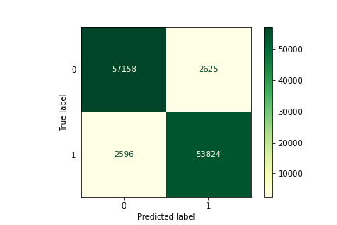
Initial Results
Apprenticeship capstone – tree coverage
Initial Decision Tree Classifier.
Metric
Precision
Recall
Accuracy
F1
95.4%
95.3%
95.5%
95.4%
Result
High metric results for Precision, Recall, Accuracy, and F1
Low number of false positives and false negatives
Next Steps:
Tune Hyperparameters
Notes:
Machine Learning Model: Decision Tree Classifier
Classification Type: Binary Classification
Tools: Python packages and Github
Evaluation metrics: Precision, Recall, Accuracy, F1
Metric Prioritization: It is more important to cut down the correct type of tree while not harming other types of trees, also we do not want to cut down all the Lodgepole Pine trees so if we miss some in the categorization, it wont be as harmful as mis categorizing other types of trees. Therefor, it is more important to have more false negatives than false positives and I will be prioritizing precision over recall.

Slide 13
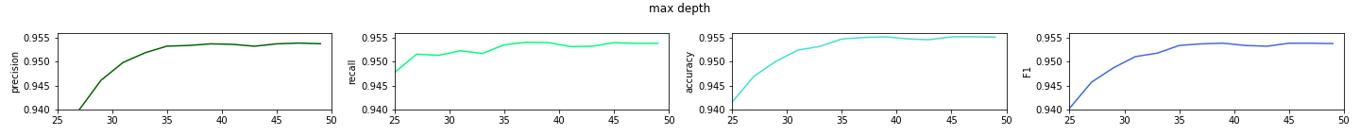
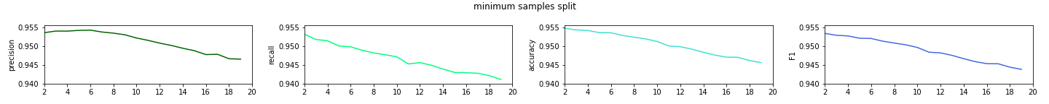
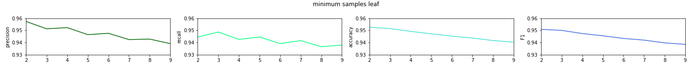
Hyperparameters
Apprenticeship capstone – tree coverage
Initial Decision Tree Classifier.
Max Depth:
Min Samples Split:
Min Samples Leaf:
Notes:
Machine Learning Model: Decision Tree Classifier
Classification Type: Binary Classification
Tools: Python packages and Github
Evaluation metrics: Precision, Recall, Accuracy, F1
Metric Prioritization: It is more important to cut down the correct type of tree while not harming other types of trees, also we do not want to cut down all the Lodgepole Pine trees so if we miss some in the categorization, it wont be as harmful as mis categorizing other types of trees. Therefor, it is more important to have more false negatives than false positives and I will be prioritizing precision over recall.

Slide 14

Secondary Results
Apprenticeship capstone – tree coverage
Results after tuning hyperparameters.
Metric
Precision
Recall
Accuracy
F1
95.3%
95.4%
95.5%
95.4%
Result
Similar metric results, but precision is slightly lower
False positives are slightly lower, false negatives are slightly higher
Conclusion:
Use initial model to determine type of tree within Roosevelt National park
Notes:
Machine Learning Model: Decision Tree Classifier
Classification Type: Binary Classification
Tools: Python packages and Github
Evaluation metrics: Precision, Recall, Accuracy, F1
Metric Prioritization: It is more important to cut down the correct type of tree while not harming other types of trees, also we do not want to cut down all the Lodgepole Pine trees so if we miss some in the categorization, it wont be as harmful as mis categorizing other types of trees. Therefor, it is more important to have more false negatives than false positives and I will be prioritizing precision over recall.

Slide 15
Approach
TABLE
We recommend a 3-phase approach to successfully design and implement a robust personalization system
1
2
3
DISCOVERY
DELIVERY
ONGOING MAINTENANCE AND SUPPORT
Focus on solution design, data model design and prioritizing capabilities
Deliver technical system and analytics consulting capabilities
Provide ongoing managed services to monitor the solution, build enhancements and provide analytical services
Technical Systems Integration
Define solution design’s technical requirements
Determine platform requirements and hardware sizing
Create personalization platform architecture
Provide detailed pricing model
Perform and participate in platform and end-to-end testing
Develop and configure platform UI
Install and configure personalization platform software
Generate and maintain solution documentation
Support the technical platforms against SLAs
Analytical Consulting
Standup and maintain machine learning algorithms
Code, test and deploy the decision logic and offers
Build reports/dashboard using out-of-the-box capabilities
Define processes to stitch together batch outbound contact history with real-time contact history
Provide guidance on how/when to adjust machine learning with data-based evidence
Maintain production models and use cases
Business Transformation & PMO
Stand up program management office
Align on estimated value and analytical model complexity to prioritize use cases and develop roadmap
Provide overall program management for technical systems and analytics workstreams
Measure value and return on use cases
Develop and implement training and knowledge transfer
Provide overall program management for technical systems and analytics workstreams
Measure value and return on use cases
Develop and operationalize intake model for new use cases
Notes:
Tags: approach, text

Slide 16
How is the current Grocery landscape changing?
Data Visualization & Infographics
Ascend is the most effective solution to help Client address challenges in an increasingly omni-channel landscape
Customers Demand
Omni-Channel Grocery Use is Emerging¹…
The Right Product at the Right Time
80%
9%
Flexible Fulfillment Options
19%
A Convenient Experience
80% of shoppers have used a digital device to browse or research Grocery products
19% of the time the use of digital increases Grocery spending
Consumers who embrace digital before or during shopping end up converting 9% more frequently than those who do not
Competitive Value
… But Quickly Accelerating²
Ascend Enables…
…to make informed business decisions
Order Online for Delivery to Home
Use Online Subscription
Order Online & Pick-Up Curbside
Order Online & Pick-Up in Store
1
2
3
22%
14%
14%
12%
Already using
55%
54%
54%
57%
A single data source of truth
Rapid, real-time insights
Scalability with Modern Technology
Willing to use
Source:
Deloitte, The Grocery Digital Divide, 2017
Deloitte, Global Spotlight on Grocery, 2018
Notes:
Tags: data visualization, landscape, infographic

Slide 17
What it will take to do this well – four factors
Subheader
1
End-to-end Digital Transformation expertise
Access to leading edge capabilities across not only digital strategy, eCommerce and digital marketing, but also the underlying technology, operations, analytics and organization implications to make change happen
2
Deep CPG insight, coupled with knowledge of your business
Deep knowledge of the right digital models that can be customized to meet both CPG client as an organization and the nuances of each category within your business
3
In-market depth and ability to make a global vision a local reality
A way to connect the dots for global and market teams already in activation mode, with resources that can slot seamlessly into place and move you rapidly to execution
4
Deep strategy experience and a strong bias toward agile execution
A means to move quickly to define a vision, integrated roadmap and governance model with expertise in how to create alignment across diverse stakeholder groups and organizational complexity
Notes:
Tags: text, list

Slide 18

Integrated ORs are gaining market traction
Subheader
Operational Efficiency
Support growing number of complex and minimally invasive (MI) surgeries
Boost time and cost savings by lowering procedure times and need for patient relocation during multi-faceted operations
Improved Patient Experience
Improve clinical outcomes
Document surgical procedure workflow and patient data for future referencing and analytics
Increase patient safety by allowing for emergency complications and remote clinician consultations to occur both inside and outside the OR
Seamless Technology Management
Streamline use of advanced technologies permeating the OR and automate equipment management
Accelerated Market Adoption
Provide two-way communication system via audio and video with third-party clinical decision makers, educators, and stakeholders
Notes:
Tags: text, photo, arrow, image

Slide 19
Digital transformations are key to enterprise sales
FRAMEWORKS & CONCEPT ILLUSTRATION
Clients are not looking to buy technologies, they are looking for solutions to business problems.
REDUCE CYCLE TIME
MAINTAIN FLEXIBILITY IN DESIGN CHANGES
DECREASE NPI TIME
CREATE AGILE SUPPLY NETWORK
REDUCE DEMAND / SUPPLY GAPS
LESSEN IMPACT FROM ENGINEERING CHANGES
INCREASE SPEED TO MARKET
To target enterprise level sales, we need to remain focused on digital transformations that present a solution to clients’ operational problems.
Notes:
Tags: icons, process, linear

Slide 20
Recommended future state operating model
FRAMEWORKS & CONCEPT ILLUSTRATION
A
CREATIVE PRODUCTION
B
LAYOUT / DESIGN
DEVELOP
PRODUCE
LAUNCH & TEST
CREATIVE BRIEF DEVELOPMENT
DIGITAL AD DESIGN & EXECUTION
PHOTOGRAPHY
VERSIONING
CONTENT SYNDICATION & DISTRIBUTION
TAB & SIGNAGE LAYOUT DESIGN
EMAIL LAYOUT DESIGN
RETOUCHING
VIDEO / MULTIMEDIA PRODUCTION
SEGMENTATION & TESTING
CONTENT DEVELOPMENT
CAMPAIGN DEVELOPMENT
COPY WRITING & EDITING
DIGITAL ASSET MANAGEMENT
LEGEND
Primary Future State Ownership
Onshore
Offshore
Associate
Contractor
Notes:
Tags: operating model, box

Slide 21
Our approach is grounded in consumer insights
Leveraging extensive research already conducted and employing a comprehensive proven approach enables us to design a truly unrivaled consumer experience
Phase I: Proposed Approach
High
Spark Ambition
Gather Insights
Develop Strategy
Model the Experience
Plan
and Execute
Measure and Adapt
Align on their winning ambition to guide all consumer engagement going forward | Identify the differentiated needs and wants across their consumers, including archetypal journeys and key moments that matter that define priority consumer experiences | Define the holistic consumer experience strategy to deliver an unrivaled consumer experience, including aspirational consumer journeys with actionable touchpoints to measure and monitor | Utilize consumer data and human-centered design thinking to define ‘signature experiences’ at the key moments that matter and design pilots to rapidly test-and-learn and refine based on real consumer feedback | Develop high-level CX roadmap and identify success measures to guide transition of the business from launch to steady state Execute: Implement plan that will continuously improve CX and fuel ongoing innovation | Conduct ongoing measurement of the consumer experience and specific activities going forward, including developing the tools and dashboards to simplify CX tracking and reporting
2 weeks | 5 weeks | 3 weeks | 2 weeks | 2 weeks
Overview
Timing¹
¹ Total timing is ~10 weeks; weeks do not add due to overlapping workstreams
Grey, Italic text indicates not in proposed scope

